Slide 1

Project
A Virtual Assistant
Presented By
Advisor
Dr. D Stalin Alex
Professor
Hasibul Islam
UG02-40-15-020
Mobassira Atika
UG02-41-16-010
Prachurja Kanti Barman Praggo
UG02-49-18-002
Department of Computer Science and Engineering
State University of Bangladesh
Department of Computer Science and Engineering
State University of Bangladesh

Slide 2
Content of table
3,4
What is a virtual assistant?
We are used
5,5
Our features
Introduction
7,8
Process of Working
Module we used
10-22
Code explanation, Conclusion,
FETURE WORK.

Slide 3

What is a virtual assistant?
AI assistant or digital assistant
An application program
Understands natural language voice commands
Completes tasks for the user
Machine to run on your command

Slide 4



We are used
python 3
Pycharm IDE

Slide 5

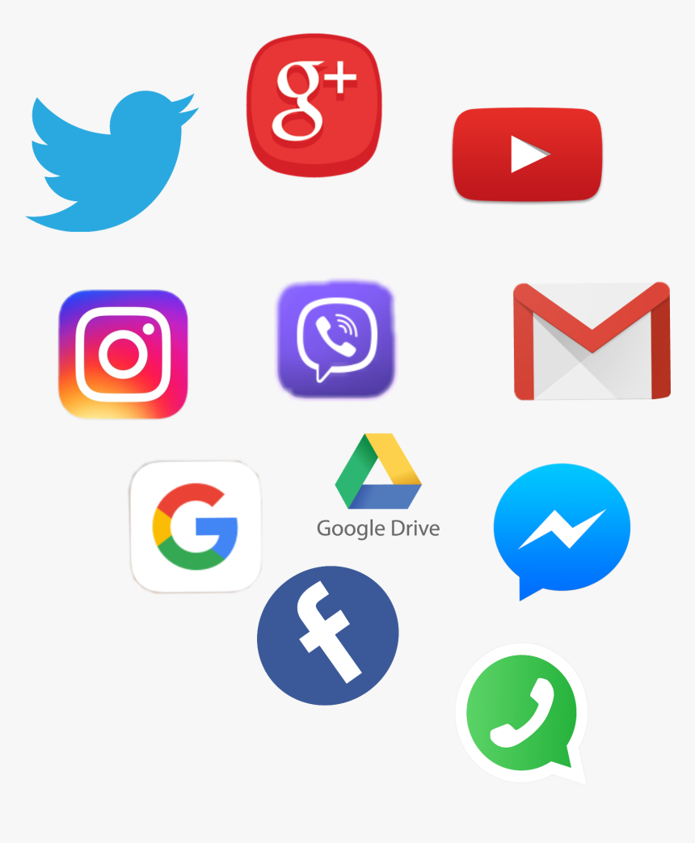

Our features
Greetings
Calculate some basic math
Answer some question
Take photo
Launch Windows Applications
Open Websites
Shut down windows
Take notes & show the notes
Tells jokes
Play songs through youtube
Answer some silly question

Slide 6

Introduction
BOB

Slide 7
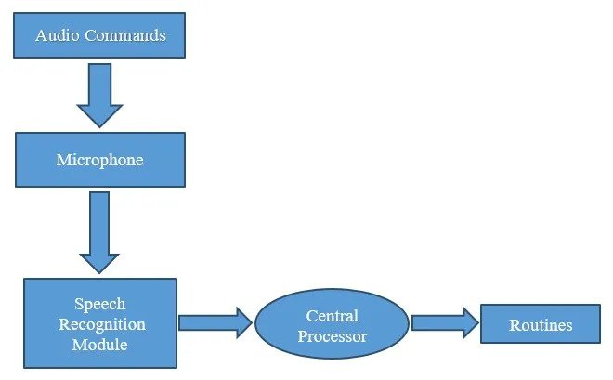
Process of Working

Slide 8

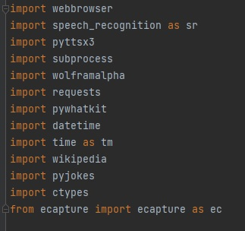
Module we used
Subprocess :- (shut down, sleep etc)
WolframAlpha :- (compute expert-level answers using Wolfram’s algorithms)
Pyttsx3 :- (for the conversion of text to speech)
Wikipedia :- (Wikipedia module to get information )
Speech Recognition :- (assistant recognizes specific voice )
Web browser :- (To perform Web Search)
Ecapture :- (To capture images)

Slide 9

Module we used
8. Pyjokes :- (collection of Python Jokes over the Internet)
9. Datetime :- (used to showing Date and Time)
10. Requests :- (is used for making GET and POST requests)
11. BeautifulSoup :- (scrape information from web pages)

Slide 10
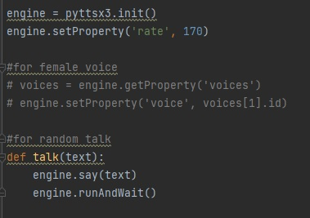
Code explanation
Defining Pyttsx3
Setting the talkback speed 170
Male & female voice
Made a function to talk

Slide 11

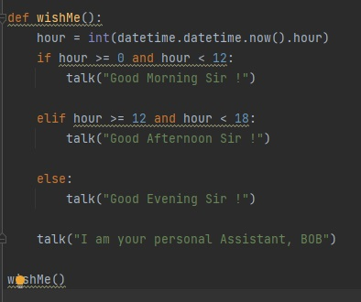
Code explanation
Greeting
Determine the time & wish
Say name

Slide 12
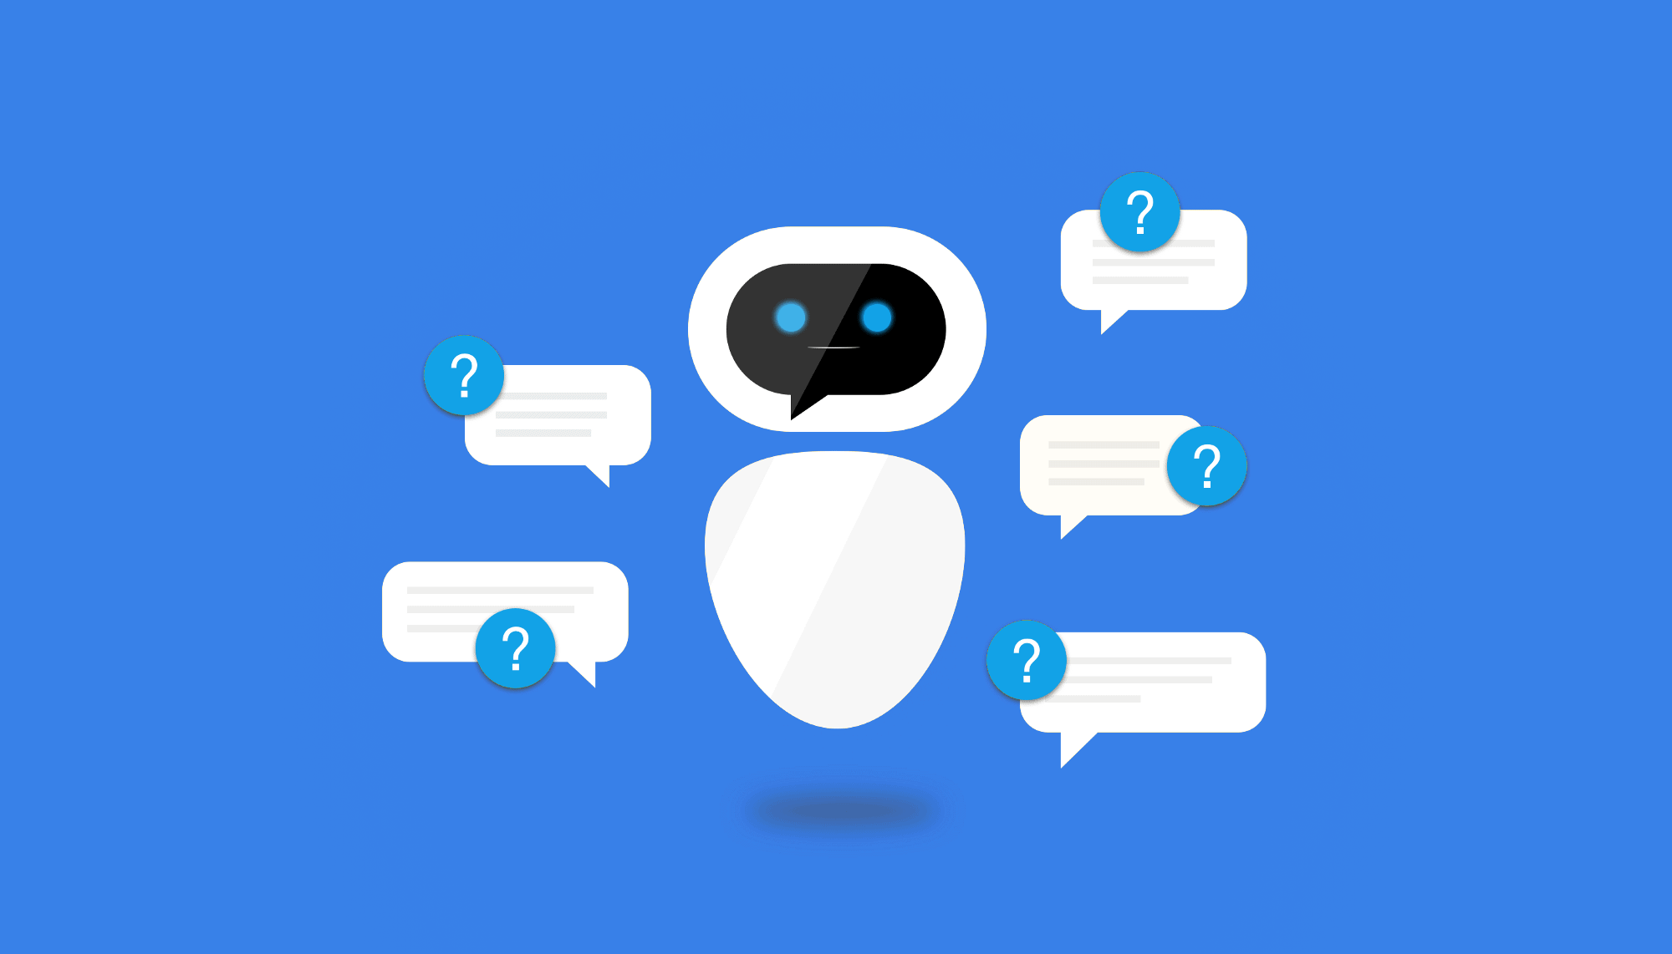
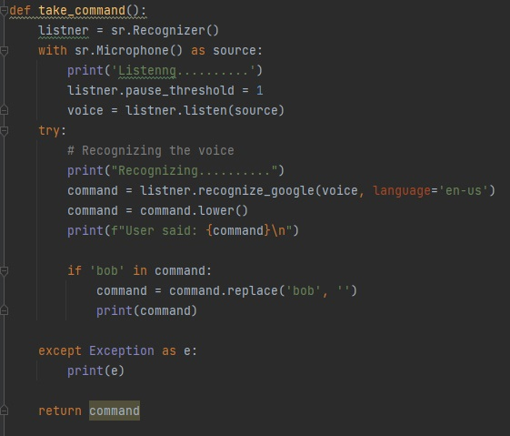
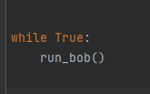
Code explanation
Take command function
Through microphone
Using Speech Recognition
Recognize the voice
Work on command
A while loop

Slide 13

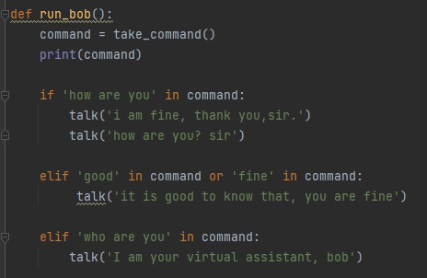
Code explanation
Defining a function run_bob()
Command with if, elif

Slide 14
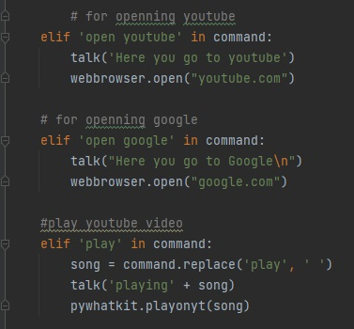
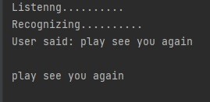
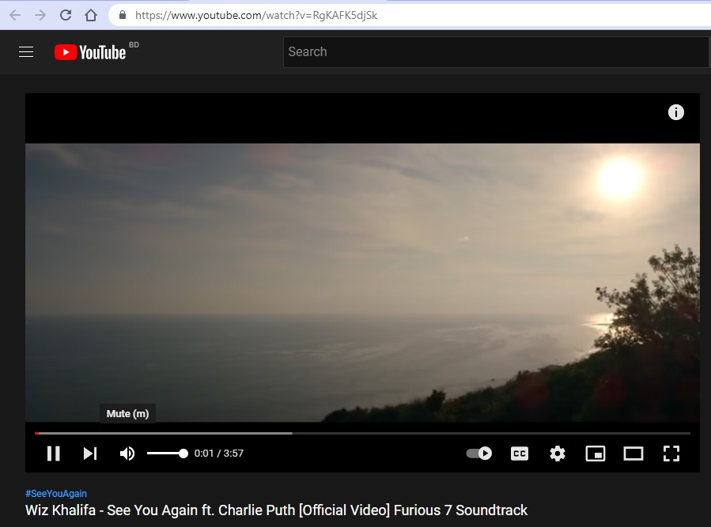
Code explanation
Open youtube
Open google
Play songs

Slide 15
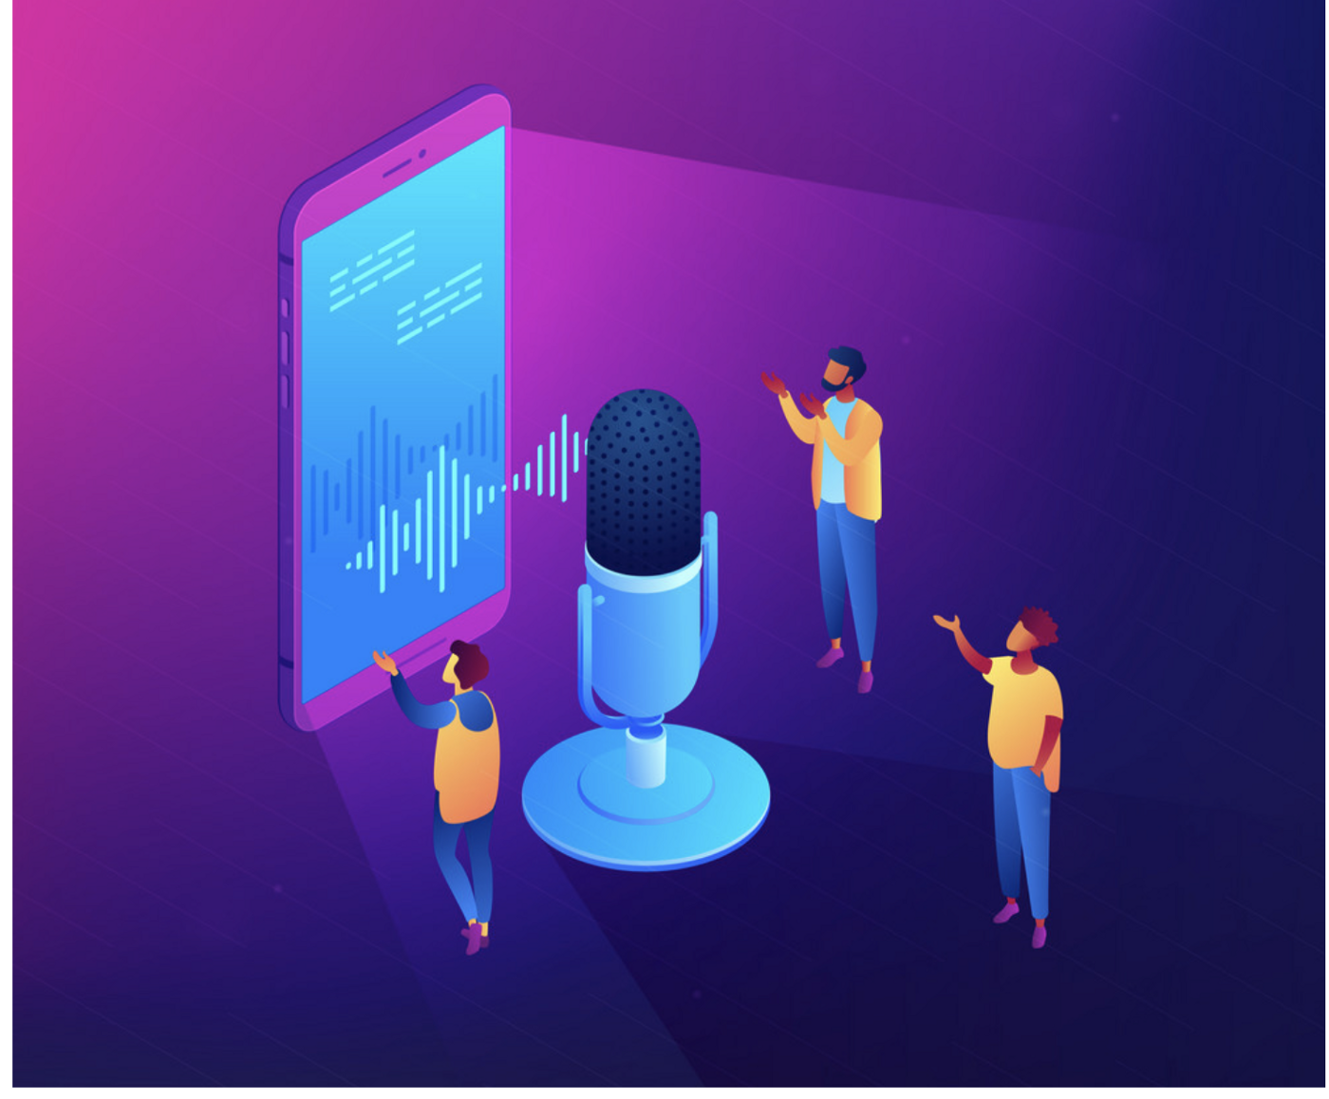
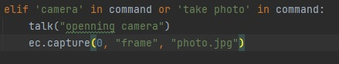
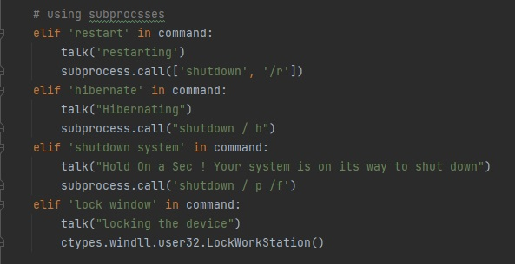
Code explanation
Taking photo
With subprocesses module
Restart
Hibernate
Shutdown
Lock window

Slide 16

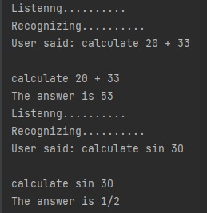
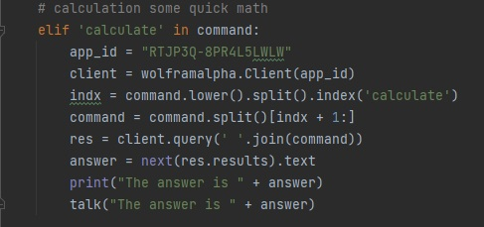
Code explanation
Calculate some basic math
Wolframalpha api id

Slide 17
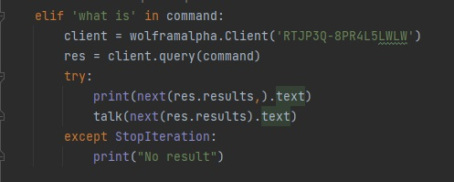
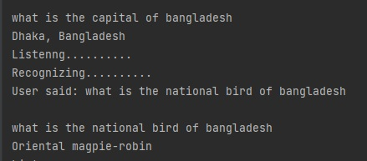
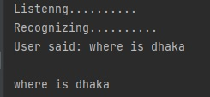
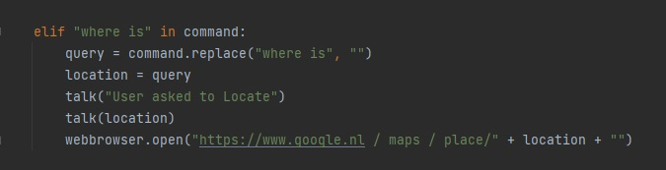
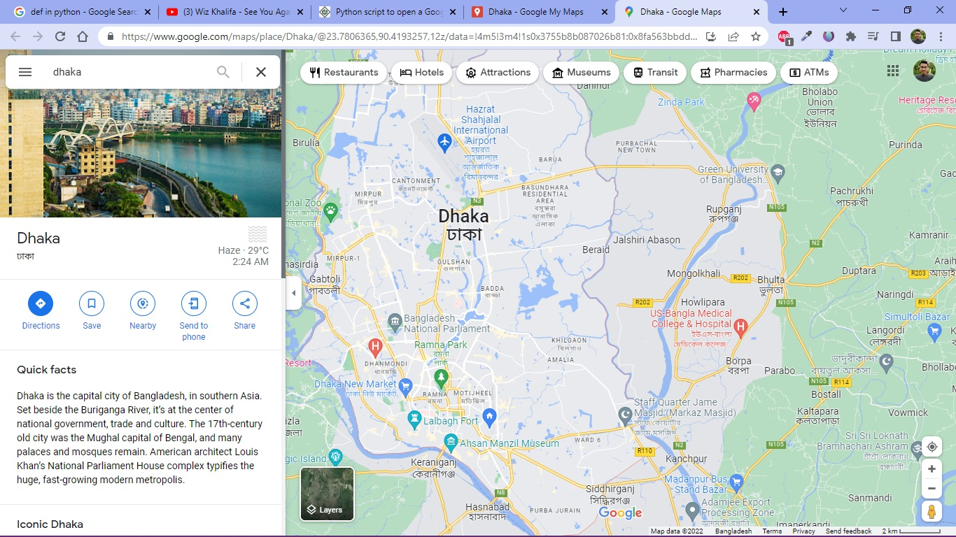
Code explanation
Answer the question
Finding location

Slide 18
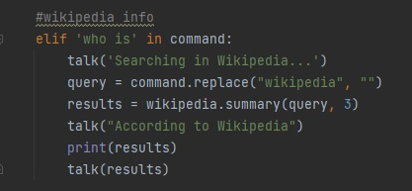
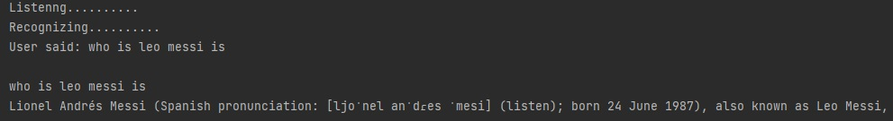
Code explanation
Finding person in wikipidia
Read out 3 line

Slide 19
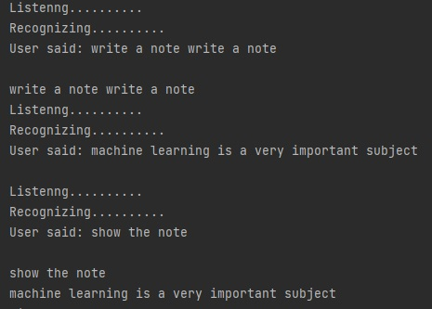
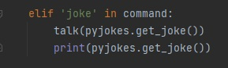
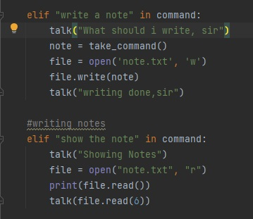
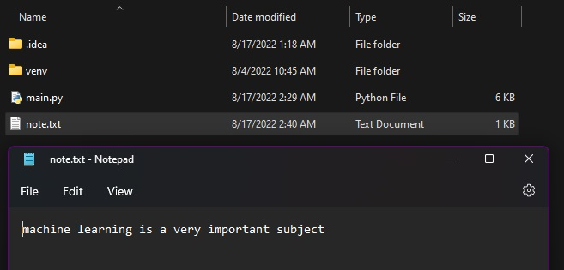
Code explanation
Tell jokes
Take notes

Slide 20

Future work
Make it more efficient
Improve the accuracy label
Use more module/function
Add more features
Make a Robot bob

Slide 21
Conclusion
Undoubtedly the next big thing
AI voice bots
Open source software modules
Comfortable and feels free
Interact with the voice assistant
Ask it questions
Always ready to help

Slide 22
References
Serial No
References
01
Geetha, V., et al. "The Voice Enabled Personal Assistant for Pc using Python." International Journal of Engineering and Advanced Technology 10 (2021): 162-165.
02
Imrie, Peter, and Peter Bednar. "Virtual personal assistant." ItAIS (2013): 98-105
Akash, S., Neeraj Jayaram, and A. Jesudoss. "Desktop based Smart Voice Assistant using Python Language Integrated with Arduino." 2022 6th International Conference on Intelligent Computing and Control Systems (ICICCS). IEEE, 2022.
03
04
Subhash, S., et al. "Artificial intelligence-based voice assistant." 2020 Fourth World Conference on Smart Trends in Systems, Security and Sustainability (WorldS4). IEEE, 2020.

Slide 23


